Slide 1
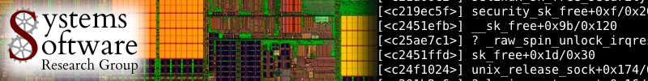


Popcorn Linux: Compiler & OS Support for Execution Migration in Heterogeneous ISA Environments
Pierre Olivier, Sang-Hoon Kim
Systems Software Research Group
Virginia Tech
polivier@vt.edu, sanghoon@vt.edu

Slide 2









Context: Instruction Set Architecture (ISA) Heterogeneity in the datacenter
Each image is copyright of the respective company or manufacturer. Images used here for educational purposes.
Notes:
Multiple OS-capable ISAs, machines with different performances and power consumption profiles according to applications and part of applications
- How to leverage this? How can we have these ISAs working together? What is the programming model (can I run legacy code)

Slide 3


Popcorn Linux Project
popcornlinux.org
Sources
(unmodified)
Multi-ISA
Compiler
musl libc
GNU
Compiler + kernel + runtime enabling native runtime migration of applications/threads across ISAs
Transform architecture specific state (stack and registers) at runtime
Support from compiler
Transfer address space
In-kernel distributed shared memory
ISA A
ISA B
X86-64
specific code
ISA A
ARM64
specific code
ISA B
application
application
application
application
op environm
single operating environment
single operating environment
op environm
krn0
krn1
krn0
Kernel 0
krn1
Kernel 1
cpu0
cpu0
cpu0
cpu1
cpu2
cpu1
cpu1
cpu2
cpu2
cpu3
cpu3
cpu3
Ethernet, Infiniband, etc.
Notes:
Popcorn ecosystem: compiler, OS + runtime to enable application and thread migration across CPUs of different instruction set architectures
Takes unmodified application sources and compile them into multi-ISA binaries (instrumented and ready for migration)
Run on machines with CPUs of different ISAs, linked through some interconnect, and communicating at the OS level
Distributed OS providing a unified operating env. based on Linux and provide basic communication and control primitives for migration
User space runtime actually performs the translation upon migration
Migration is:
Transform arch specific state (mostly stack) using metadata from the compiler
Transfer on-demand the rest of the address space

Slide 4
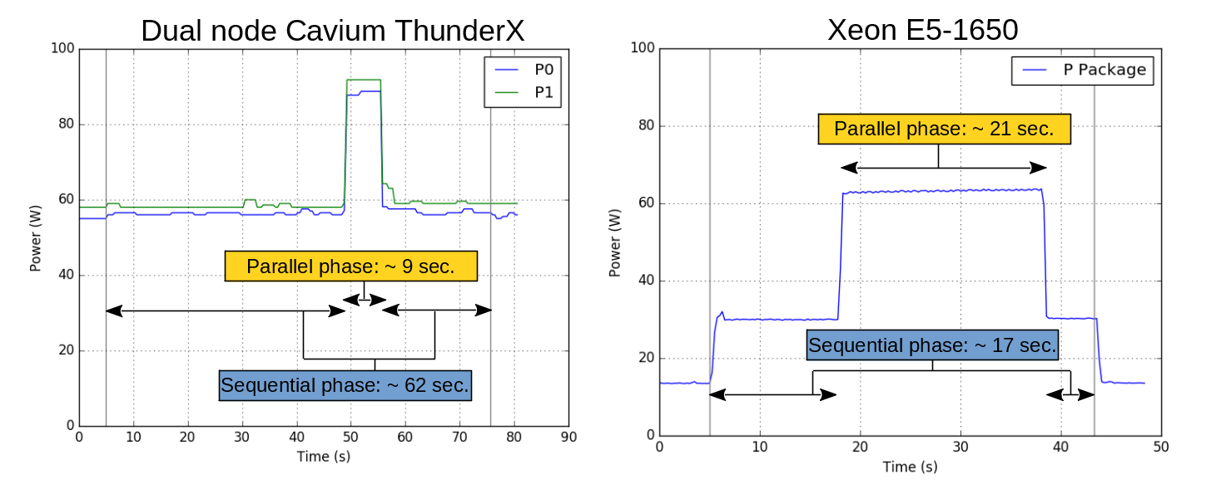
Motivation
Smart consolidation, load balancing for performance & energy gains
ISA/Machine affinity:
Program phases illustration: PARSEC blackscholes native input
96 cores @2Ghz
6 cores @3.2Ghz
Notes:
Talk about sequential and parallel phases:
Seq: one core at 100% (not only IO)
Parallel: all cores
Assuming a zero-cost migration time:
Executing the right phase on the right machine would yield:
32% execution time reduction compared to an only Xeon execution
63% execution time reduction / 76% energy consumption reduction compared to an only Cavium execution.

Slide 5
Outline
Compiler/toolchain support for multi-ISA binaries
OS support for heterogeneous migration
Evaluation, ongoing and future work
Conclusion

Slide 6
Outline
Compiler/toolchain support for multi-ISA binaries
OS support for heterogeneous migration
Evaluation, ongoing and future work
Conclusion

Slide 7
Popcorn Compiler Framework: Compiler Support for Heterogeneous-ISA Platforms
Pierre Olivier (polivier@vt.edu) Postdoctoral Associate
Work done by Robert Lyerly (rlyerly@vt.edu)
Notes:
Credits to Rob

Slide 8
Introduction
Goal: seamlessly run shared-memory/compiled applications across heterogeneous-ISA CPUs: no effort for the programmer
Programmability and legacy support
Use well-understood, high-performance languages like C/C++
Compatible with legacy POSIX applications
No manual application refactoring or partitioning of code across ISAs
Manageability
Enable system software to decide where to run applications
Transparently leverage performance/energy benefits from diverse processors
Notes:
For programmability reasons we focus on application written using the classical shared memory programming model
Popular languages C C++
No effort from the programmer to redesign the application or partition it across ISAs
Manageability: ecosystem enable automatic migration/distribution decisions without any explicit input from the programmer to leverage the benefits brought by heterogeneous environement

Slide 9
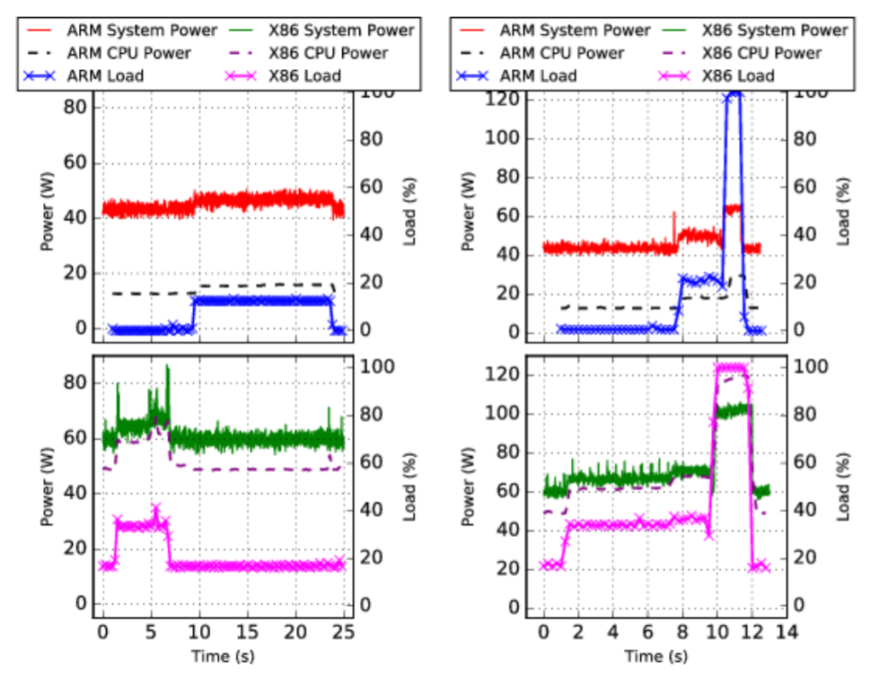
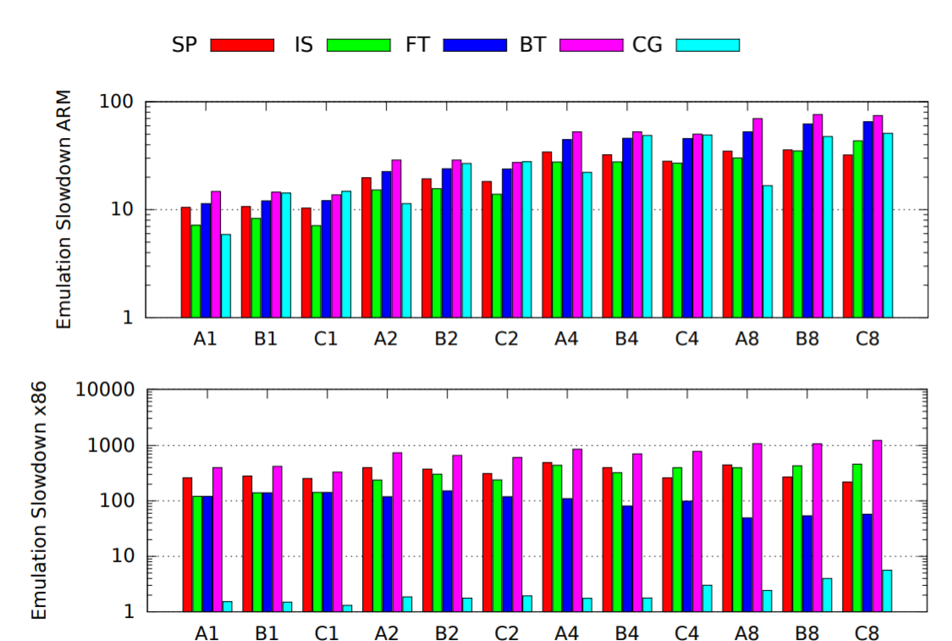
Current Approaches
Message Passing Interface (MPI)
Complex code development/refactoring
ISA Virtualization
Managed languages, e.g., Java
Rewrite application from scratch
Performance overheads
Dynamic binary translation, e.g., QEMU
Run unmodified binaries
Order of magnitude slowdown
Notes:
Message passing interface:
Significant developer effort
Redesign entire application for legacy code
Manual data movement
Virtualization
Managed languages - compile source code to intermediate representation, interpret by language VM on each ISA
VM virtualizes ISA, can automate some data transfers
Rewrite in new language – legacy not supported
Significant performance overheads
VM tasks, e.g., garbage collection
Interpreter/JIT compiler overheads
Data transfers are slow
System emulation – lift ISA-specific machine code to IR, re-compile down to host ISA

Slide 10
Multi-ISA Binaries
Popcorn Compiler Toolchain builds multi-ISA binaries
Create mostly-common virtual address space
Valid across all ISAs
Instrument generated code with migration points
Insert translation metadata
Used by runtime to dynamically transform thread execution state (stack, registers) between ISA-specific formats at migration time
Compile
C/C++ Source
Link
Popcorn Toolchain
Post-Processing
Data
x86-64 Code
Data
ARM64 Code
Transform Metadata
Transform Metadata
Notes:
Popcorn Toolchain creates two binaries with minimal architecture specific differences: content of the code section
For the rest (data): assume little endian and same size for primitive types
Layout each symbol at the same address in the virtual address space to maintain reference validity across migration
Mostly-common address space solves almost all issues related to references. The exception is pointers to the stack, which are a nuisance. There’s two ways to handle them:
Venkat – align stack objects (whose addresses are taken) at identical stack slots across all ISA-specific stack formats. Very complete but highly invasive inside the compiler.
Me – at runtime, update references to stack objects to point to their relocated address. See next slide for more information on relocation costs.
My approach can lead to problems when passing references to stack objects to other threads, but this is generally considered an anti-pattern. There are a few places where this is valid, e.g., OpenMP shared variables, and I’m working on a possible solution.

Slide 11
Multi-ISA Binaries
Minimize costs of migrating threads between ISAs
Reification – cost of changing the binary representation to match what’s supported by the ISA
Data: no cost, assume little-endian & equal sizes for primitive types
Code: cost incurred offline – compiler generates code for each ISA
Relocation – cost of moving data to different addresses
Cost of copying memory between different addresses
Cost of updating references (e.g., pointers) to those binary objects
Notes:
This is a little more about the fundamental underpinnings on migration & its costs. This is probably too low-level for a presentation, but is in here for informational purposes.
x86-64 is strictly little-endian, but PowerPC & ARM64 are bi-endian.
Reification of data: there is a cost if you look to more extravagant types like IEEE quad-precision (128-bit) floating point. Some architectures support it, some don’t (and require software emulation). SIMD is another pain point. We disallow these types for now.

Slide 12
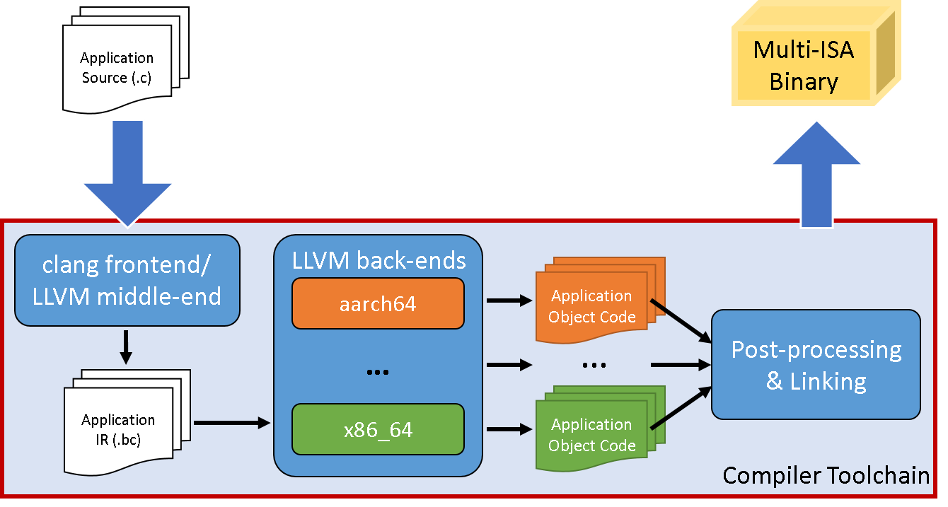
Popcorn Compiler Toolchain
Built on top of clang/LLVM
clang/LLVM 3.7.1, GNU gold 2.27 (~8k LoC)
Virtual address space alignment tool (~1.5k LoC)
State transformation/migration libraries (~4.5k LoC)
Notes:
Modify clang/LLVM to emit multi-ISA binaries
Lower application source into LLVM IR
Insert migration points at function entry/exit (library function call)
Analyze and instrument LLVM IR
Run liveness analysis to determine which program variables are alive at potential transformation sites, i.e., all function call sites
Adjust linkage of global variables & add symbol names so alignment tool can adjust layout
Because we use single set of IR, can guarantee implementations are semantically equivalent, i.e. isomorphic
In back-ends
Record where live values are allocated in function activation, i.e., registers or stack slots
Stack transformation runtime uses this metadata to transform stack
Record frame unwinding metadata
Similar to DWARF, but MUCH faster
Customized linking & post-processing creates uniform virtual memory space, adds stack transformation metadata to binaries

Slide 13
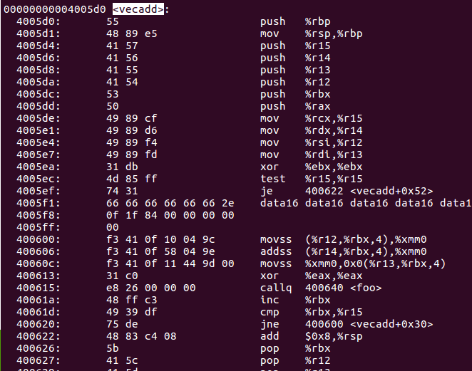
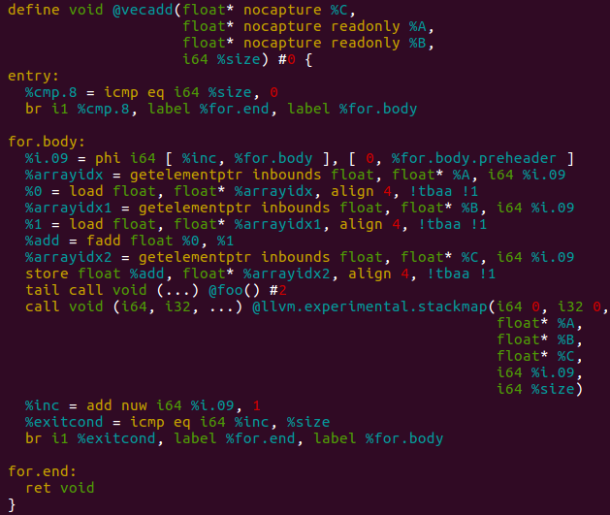
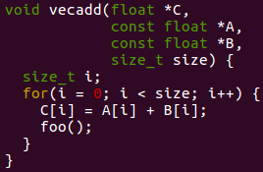
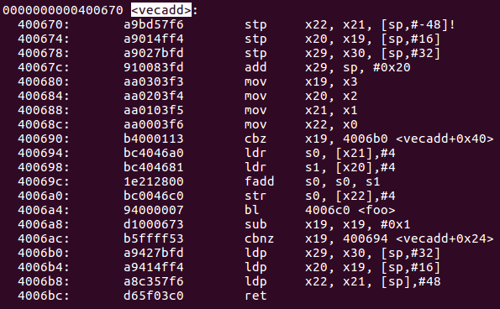
Code Generation
C/C++
ISA-Agnostic LLVM IR
ISA-specific Machine Code
Record where live values are allocated, e.g “i” stored in %rbx
Track live values at the IR level
…
Notes:
The LLVM toolchain
Clang – “C language frontend” – consumes C/C++ and emits LLVM IR
LLVM middle-end – language & architecture-agnostic optimizer – consumes LLVM IR and emits LLVM IR
LLVM back-end – code generation (e.g., instruction selection, register allocation) for each ISA – consumes LLVM IR and emits machine code
We track live values in the IR using the “stackmap” intrinsic (https://llvm.org/docs/StackMaps.html). We add live values as an argument to the stack map, and during the code generation (LLVM backend) phase each ISA’s backend records where the IR-level value is allocated for each ISA.
LLVM’s bitcode/IR is *mostly* ISA-agnostic because some ISA-specific operations get exposed in the IR, e.g., atomic operations, built-ins (hardware transactional memory functionality)

Slide 14
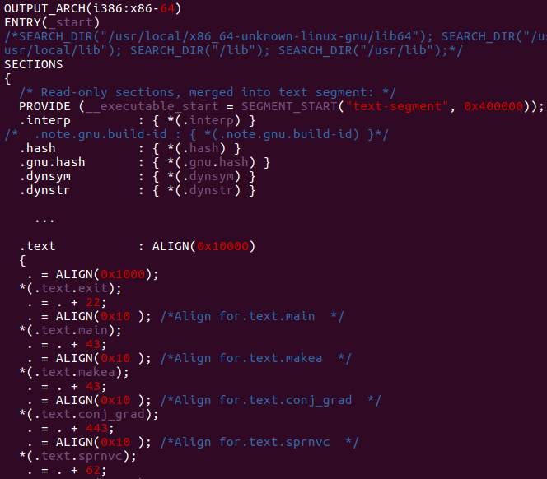
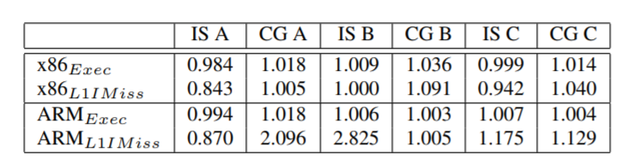
Linking & Post-Processing
Generate linker script to align symbols across compilations for all ISAs
Post-process metadata from all compilations to clean and prepare for runtime state transformation
Notes:
Post-process = rearrange LLVM’s stackmap section into my own sections.

Slide 15
Migrating Between Architectures
Insert migration points into code
Can only transform stack at equivalence points
Direct mapping of execution state between ISA-specific formats
Scheduler cannot migrate threads at arbitrary points, must signal threads to initiate migration process
void foo() {
migration_check();
… (execute foo) …
migration_check();
}
Thread
Migrate thread?
Scheduler
Transform execution state & migrate
No
Yes

Slide 16
Migrating Between Architectures
Migration procedure:
Transform stack & register set between ISA-specific formats
Rewrite all open function activations from top to bottom
Pass transformed state to OS thread migration service
Thread bootstraps in well-known program location on destination processor & resumes at same location
Notes:
Stack transformation
Read the thread’s register set & attach to the stack
Unwind the stack to find live function calls & calculate size for new stack
Transform each frame between ISA-specific formats, i.e. copy live values to the appropriate locations
Thread migration service: __sched_setaffinity_popcorn system call
OS copies PC, SP & FBP between ISA-specific equivalents (heterogeneous continuation)
Resumes in well-known location, fixes up floating-point registers (kernel doesn’t want to touch them)

Slide 17
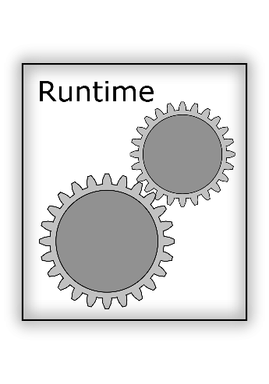
State Transformation
Function: foo
Call site: 193
Call frame size: 32 bytes
Return address: 0x412820
Function: foo
Call site: 193
Call frame size: 40 bytes
Return address: 0x412700
Source
Destination
Function: bar
Call site: 37
Call frame size: 16 bytes
Return address: 0x410204
Function: bar
Call site: 37
Call frame size: 32 bytes
Return address: 0x410198
Function: baz
Call site: 10
Call frame size: 32 bytes
Return address: 0x410548
Function: baz
Call site: 10
Call frame size: 48 bytes
Return address: 0x410532
Top of Stack
Notes:
1st phase of runtime: read the thread’s current stack, which lets us find the open function activations & their associated metadata entries. We can then calculate the size of the transformed stack from their metadata entries.

Slide 18
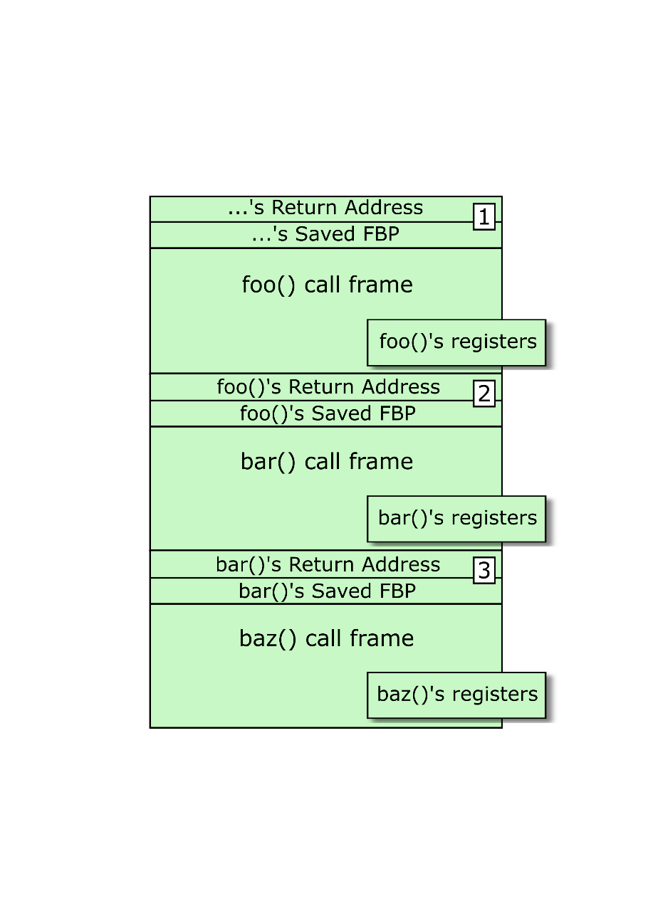
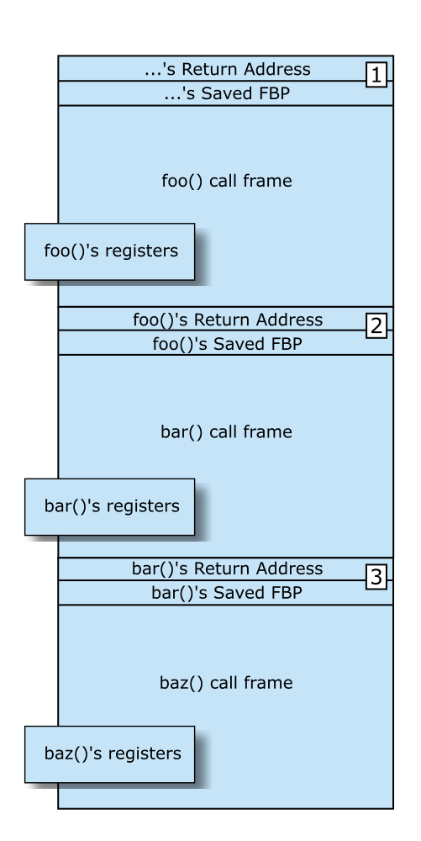
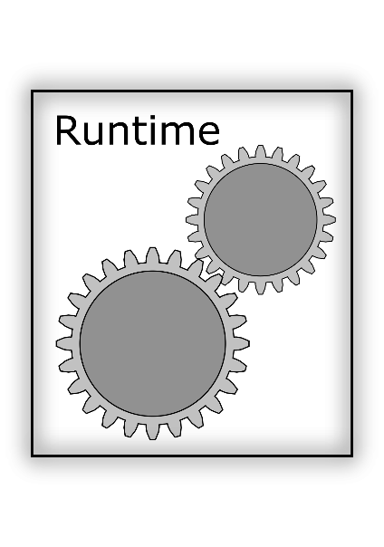
State Transformation
Function: foo
Call site: 193
Call frame size: 40 bytes
Return address: 0x412700
Function: bar
Call site: 37
Call frame size: 32 bytes
Return address: 0x410198
Notes:
The runtime handles pointers to stack variables as well:
The compiler generates enough type information to tell the runtime whether a live value is a pointer
When copying a pointer between the source & destination activations, the runtime checks if it points to within the stack’s bounds
If so, the runtime records a “fixup”, meaning that the pointer needs to be reified after the pointed-to data has been relocated to the transformed stack
When copying stack-allocated data from source to destination, the runtime checks if any fixups point to the data on the source stack. If so, the pointer is reified on the destination stack

Slide 19
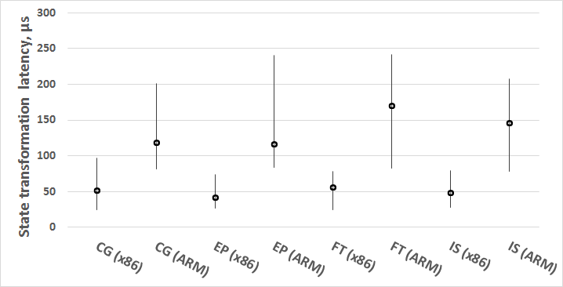
State Transformation
How fast is state transformation?
Notes:
State transformation latency for all migration points across several NPB applications
Graph shows minimum, average, maximum latencies

Slide 20
Summary
Compiler generates multi-ISA binaries
Lower source to ISA-agnostic LLVM IR
Instrument with migration points
Lower single set of IR to multiple ISAs
Track where live values are allocated for each ISA
Supports a number of architectures (not just ARM & x86)
Align binaries & add transformation metadata
Runtime migration
Coordinate with scheduler to migrate threads
Attach to thread’s registers & stack, rewrite in its entirety

Slide 21
Outline
Compiler/toolchain support for multi-ISA binaries
OS support for heterogeneous migration
Evaluation, ongoing and future work
Conclusion

Slide 22
OS Support for Heterogeneous Migration
Sang-Hoon Kim (sanghoon@vt.edu)
Postdoctoral Associate

Slide 23
On the OS side …
Migrate threads
Provide consistent memory

Slide 24
Thread migration
Equivalent to perform the context switch across machines
At origin: Save the execution context
The user-space library provides the register set
thread_struct + mm_struct
At remote: Restore the context on a thread
Fork a kernel thread, and downgrade it to a user thread
Construct mm_struct and associate it with the thread
Update pt_regs and thread_struct
Return from the kernel space
➔ Resume execution as if returned from system call
Exec.
contexts
Exec.
contexts
Origin
Remote

Slide 25
Memory consistency protocol
Provide consistent memory to distributed threads
VMA (vm_area_struct)
Metadata for pages in a range of address space
E.g., types, permission, backing files, offset in files, …
Page (page)
Data

Slide 26
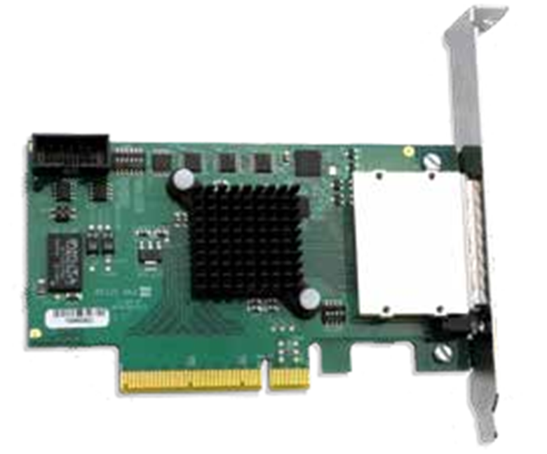
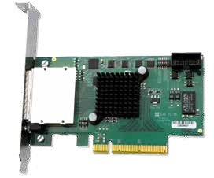
Memory consistency protocol VMA
Migrate to ARM
str x1, [sp,#0xbeef]
.text (x86)
VMA
Map
Single System Image
VMA
Map
Original thread
Remote thread
send page containing sp + 0xbeef
Kernel 1
Kernel 2
Page fault at @str
.text (ARM)
Page fault at sp + 0xbeef
Notes:
When we decide to migrate the thread, kernel 1 tells kernel 2 to set up OS-side data structures
The user thread is migrated by the kernels (it goes to sleep on kernel 1 and is re-instantiated on kernel 2), and as it begins fetching instructions, kernel 2 maps the ISA-specific machine code into memory
The OS knows that it’s fetching instructions from a code page by permission bits (executable, readable), so rather than migrating the page from kernel 1 it loads the page from disk
The thread starts accessing data and causes a page fault because the page it tries to access is not mapped into memory
str (store register to memory), x1 is an integer register, [sp, #0xbeef] means the address generated by adding 0xbeef to the stack pointer register
Kernel 2 realizes that the thread is in the heterogeneous container, so at the page fault it asks kernel 1 if it has the page needed by the thread
Kernel 1 unmaps the page and sends it to kernel 2, who maps it into the thread’s address space and resumes the thread’s execution

Slide 27
Memory consistency protocol Page
Centralized for the implementation feasibility
Track the ownership for each page at the origin
Remote threads request missing pages to the origin
The origin handles the requests accordingly
Model the simple RMI cache coherent protocol
Read-Modify Invalidate
Read replicates a page
Write gets exclusive access to the page
Invalidates the page from other nodes
Local
Read
Write
Read
Write
Exclusive
Shared
Write
Read

Slide 28
Memory consistency protocol Read
Remote 1
Origin
Remote 2
0
0
0
RW
Read
1
1
1
2
2
2
3
3
3
4
4
4
5
5
5
6
R
6
6
7
7
7

Slide 29
Memory consistency protocol Read
Remote 1
Origin
Remote 2
0
0
0
Read
RW
1
1
1
2
2
2
3
3
3
4
4
4
Read
5
5
5
6
R
6
6
Read
7
7
7

Slide 30
Memory consistency protocol Write
Remote 1
Origin
Remote 2
0
0
0
RW
1
1
1
2
2
2
3
3
3
Write
4
4
4
5
5
5
6
R
6
6
7
7
7

Slide 31
Memory consistency protocol Write
Remote 1
Origin
Remote 2
0
Invalidate
0
0
RW
Write
1
1
1
2
2
Grant
2
3
3
3
4
4
4
5
5
5
6
R
6
6
7
7
7

Slide 32
Memory consistency protocol In reality …
Page faults are inherently concurrent
Each thread can raise a page fault
Multiple faults for different pages
Multiple faults for a page
In addition, faults can be happened simultaneously at the origin and remotes

Slide 33
Memory consistency protocol In reality …
Current optimistic fault handling complicates ownership tracking
Threads independently prepare faulty pages
Serialized by PTE spinlock for PTE fixup
May discard the prepared page if other already fixed up the PTE
Remote fetch updates the ownership status at the origin
Cannot just discard the page fetched from the origin…
Locking gets more complicated
Cannot hold PTE spinlocks while fetching pages over interconnect
Different PTE lock granularity for architectures and configurations

Slide 34
Fault coalescing
Track outstanding fault handlings
Merge the same type of faults to the same page
The first thread staging a fault for a page becomes the leader
The leader executes the actions to handle the fault
E.g., fetch the page from origin/remote, fix up PTE, …
Followers piggyback on the leader’s work
W
R
R
Fault stage
0xbeef

Slide 35
Outline
Compiler/toolchain support for multi-ISA binaries
OS support for heterogeneous migration
Evaluation, ongoing and future work
Conclusion

Slide 36
Evaluation
66% gain!
30%
11%
Workload sets drawn from HPC benchmark suite (NPB)
E5-1650 & APM XGENE
Popcorn yields 30% energy savings on average (max is 66% for set-3)
Popcorn yields 11% reduction in energy-delay product
36

Slide 37
Preliminary result NPB EP

Slide 38




Ongoing and future work
Popcorn Linux extension to PowerPC64
Popcorn Xen: unikernels migration across ISAs
Unikernels are minimalist statically compiled guests VMs
Application + libraries + thin OS layer
Simpler to migrate across ISA than regular VM
Leverage the HermitCore unikernel and the KVM migration infrastructure
http://www.hermitcore.org/

Slide 39
Outline
Compiler/toolchain support for multi-ISA binaries
OS support for heterogeneous migration
Evaluation, ongoing and future work
Conclusion

Slide 40
Conclusion
Multiple OS-capable ISAs present in the datacenter
Each one with pros and cons
Popcorn infrastructure allows to reap the benefits from these ISAs by having them cooperate
To leverage ISA/Machine affinity, and perform smart consolidation/load balancing
Tools and mechanisms: heterogeneous compiler + distributed OS + DSM
Application and thread migration/distribution across ISAs
Unmodified applications enables high programmability: POSIX/shared memory run as-is

Slide 41





























Thank you
popcornlinux.org
ssrg.ece.vt.edu

Slide 42
Backup slides - compiler

Slide 43
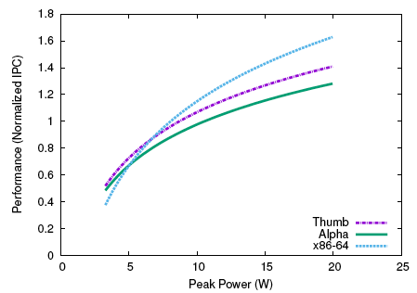
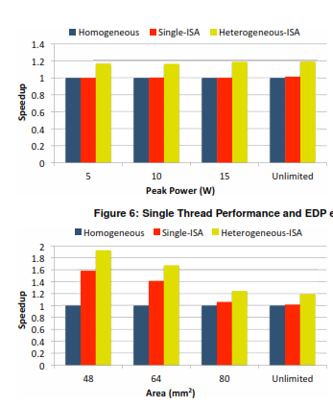
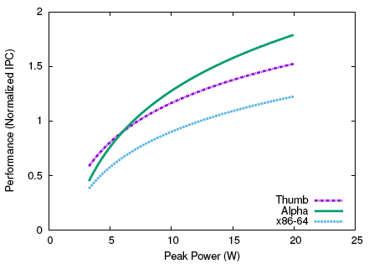
The Case for Heterogeneous-ISA Multicore
Single thread performance for different area budgets
Phase 1
Phase 2
Core Area (mm²)
Smaller the core area, greater # of cores can be placed on the silicon
Performance of bzip2's two different phases for different peak power budgets
Alpha
big Alpha
medium Alpha
little Alpha
ARM’s thumb
x86_64
Alpha
“Harnessing ISA Diversity: Design of a Heterogeneous-ISA Chip Multiprocessor,” A. Venkat and D. M. Tullsen, ISCA 2014.
43

Slide 44
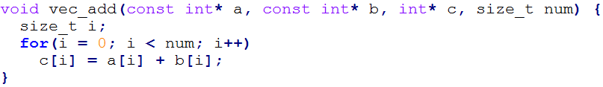
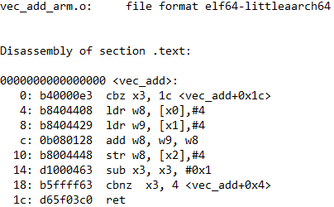
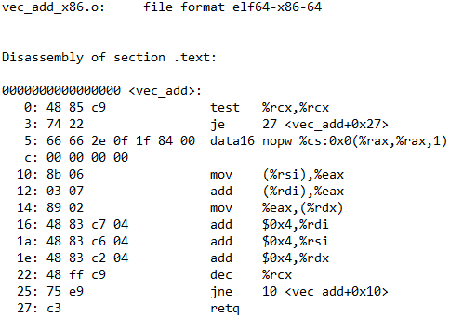
Fine-Grained Migration
Can only migrate at equivalence points
Scheduler must wait for thread to reach equivalence point
Perform addition & update pointers
Perform addition
Update pointers
Notes:
Compiler implements program logic using features of each ISA
In this example:
ARMv8 has extremely flexible memory access capabilities, updates array pointers while performing addition
x86 doesn’t mix math with memory address generation, compiler generates addition and pointer updates in separate instructions
Green line denotes equivalence point

Slide 45
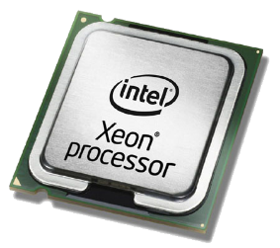
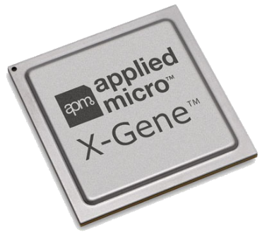
Fine-Grained Migration
Previous idea: use dynamic binary translation (DBT) to emulate up until equivalence point [Venkat’15]
Thread
Reached equivalence point
x86-64 Code
ARM64 Code
DBT Framework
Thread
Migrate to ARM
Scheduler
Notes:
Downsides
Expensive – need to lift assembly to IR and then code-gen
May take a while to warm up code cache
Contention on emulator data structures in multithreaded scenarios
Code bloat – either put DBT framework in kernel (increase attack surface), or tie DBT into each application

Slide 46
Fine-Grained Migration
New Idea: use hardware transactional memory to roll back to most recently encountered equivalence point
Roll back to previous equivalence point
cache
x86-64 Code
ARM64 Code
. .
. .. .
Thread
HTM buffer
Thread
Migrate to ARM
Scheduler
Notes:
Hardware transactional memory
Used for concurrency control, basically implements checkpointing in HW
As threads execute, start checkpointing at equivalence point
When we reach the next equivalence point, commit results & start new checkpoint
Downsides
Processors must implement HTM (Intel x86 TSX, Power8 HTM)
Limitations in buffer sizes (4MB read, 22KB write on Intel; 8KB read, 8KB write buffer on Power8)

Slide 47
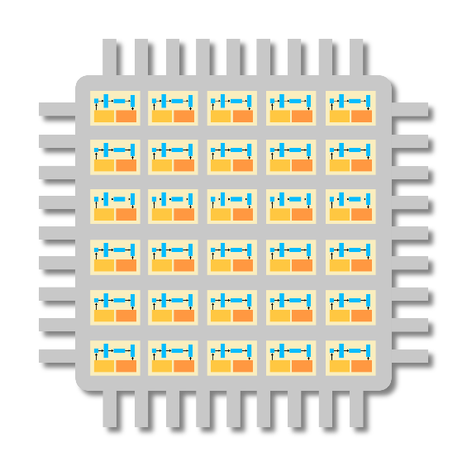
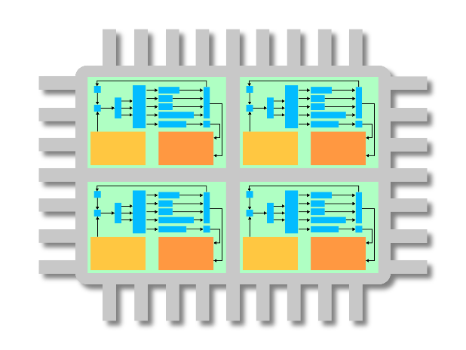
Work-Sharing Across Processors
OpenMP runtime currently only executes threads on single architecture
Idea: launch threads across multiple processors, split parallel work across available resources
OpenMP Work
Multi-core
Many-core
Notes:
Work splitting across devices well studied in CPU/GPU literature
Programmability issues, limitations in kernel complexity, developer oftentimes has to help split data
Build new OpenMP runtime for smart load balancing across architectures
Use messaging layer to transparently migrate data
Runtime should dynamically adapt load across architectures
Load balance based on capabilities
Smart mapping of threads/customized data layout to prevent false sharing & page “ping-pong”

Slide 48
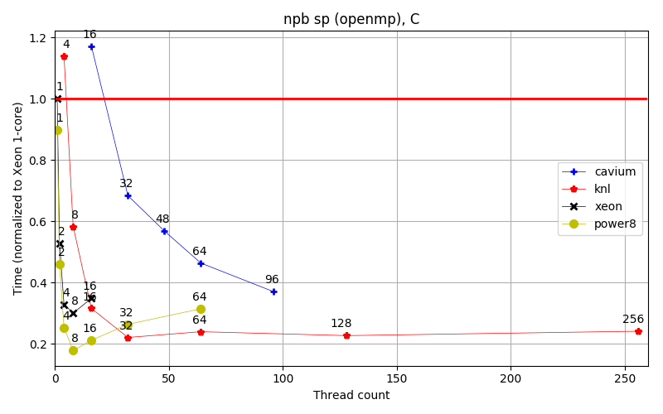
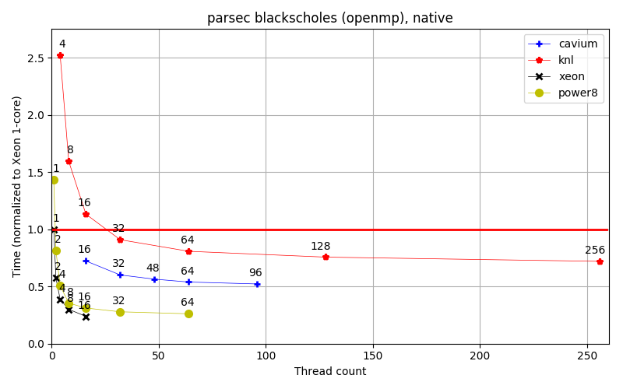
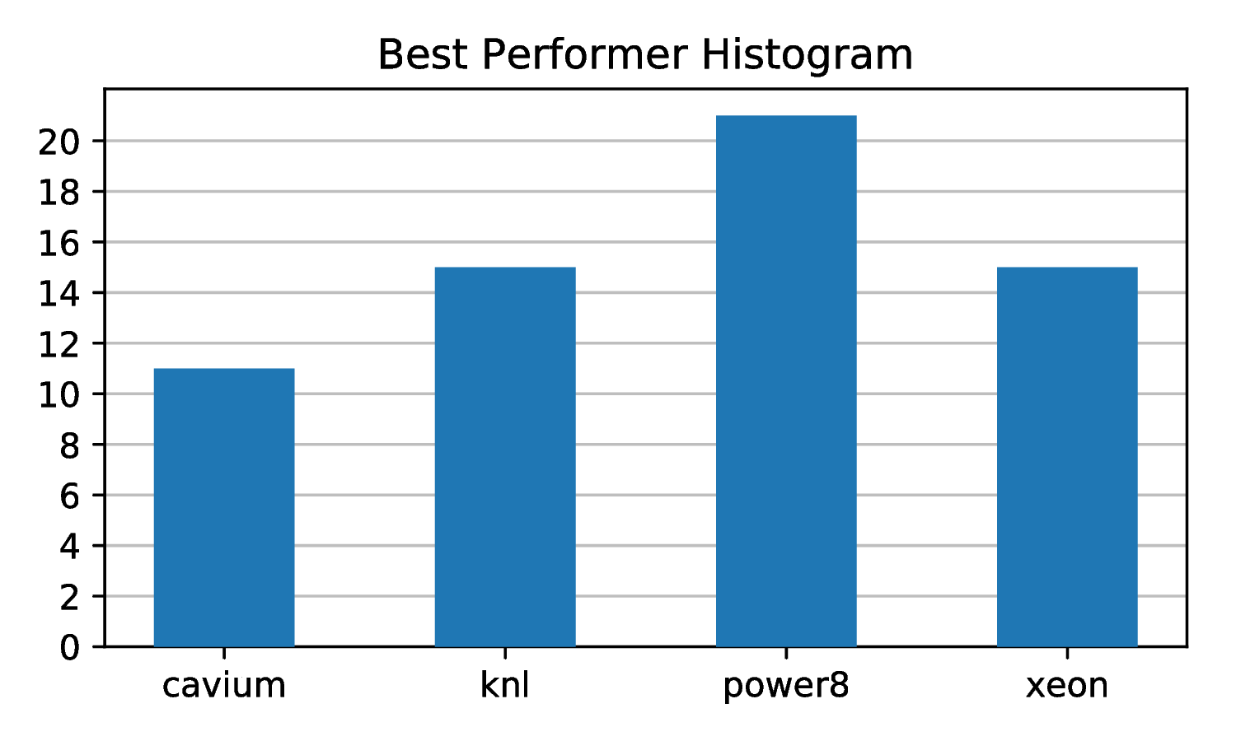
Extensions to New ISAs
Popcorn currently supports ARM64/x86-64

Slide 49
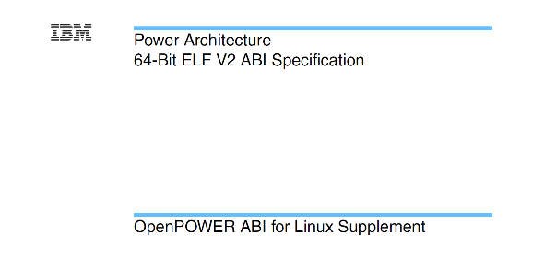
Extensions to New ISAs
Extend to new platforms, i.e., POWER8, SPARC
Different performance/power/cost design points
Idea: build “compiler-compiler” to automatically generate support for new architecture
LLVM Module
Compiler-compiler
State Transform Module

Slide 50
Backup slides – OS support

Slide 51
Memory consistency protocol In reality …
Remote 1
Origin
Remote 2
Read
0
0
0
Write
Read
RW
1
1
1
Write
Write
Write
Read
2
2
2
Read
Write
3
3
3
4
Invalidate
4
4
Write
5
5
5
Write
6
R
6
6
7
7
7

Slide 52
Tracking ongoing fault handling
Track outstanding fault handlings
Stage ongoing fault handlings on “fault stage”
Coalesce similar type of faults if possible
<Local read> + local reads
<Local write> + local writes
Otherwise, wait until the ongoing fault is handled or retry
A leader handle the fault on behalf of other followers
Notes:
<Local write> + local read
<Local read> + remote reads
<Remote read> + local reads
…

